Slide 1

WELCOME

Slide 2
SQL Database Design for Online Shopping Systems
Presented By : Thorat Vaishnavi Sitaram

Slide 3
Tables Included
USERS (Stores user details)
CATEGORIES (Manages product categories)
BRAND (Stores brand information)
PRODUCT (Links to categories and brands)
ORDERS (Tracks user purchases)
ORDER_ITEMS (Handles multiple products in orders)
PAYMENTS (Manages transactions)
ADD_TO_CART (Stores pending purchases)
ADDRESS (Manages user shipping addresses)

Slide 4

Introduction
This SQL database is designed for an online shopping system, ensuring secure, efficient, and scalable data management. It handles user authentication, product categorization, order processing, payments, and shopping cart functionality.

Slide 5

Objectives
✔ Ensure efficient and structured data management
✔ Maintain data integrity and security using constraints
✔ Provide seamless user experience for shopping
✔ Optimize order and payment processing
✔ Enable shopping cart functionality
✔ Support multi-address storage for users
✔ Enhance scalability and performance

Slide 6

Key Features
🔹 User authentication and registration
🔹 Product categorization with brand association
🔹 Shopping cart management
🔹 Secure order processing and tracking
🔹 Multiple payment methods with transaction tracking
🔹 Address management for shipping

Slide 7
SQL Query For :USERS TABLE
CREATE TABLE USERS
(
U_ID NUMBER(10) PRIMARY KEY,
USER_NAME VARCHAR(25) NOT NULL,
USER_EMAIL VARCHAR(25) UNIQUE NOT NULL,
PASSWORD VARCHAR(20) UNIQUE NOT NULL,
PHONE_NO NUMBER(10) UNIQUE NOT NULL,
USER_ADDRESS VARCHAR(250) NOT NULL
);

Slide 8
SQL Query for : CATEGARIES TABLE
CREATE TABLE CATEGARIES
(
CATEGARY_ID NUMBER(10) PRIMARY KEY,
CATEGARY_NAME VARCHAR(250) NOT NULL
);

Slide 9
SQL Query for : BRAND TABLE
CREATE TABLE BRAND
(
BRAND_ID NUMBER(10) PRIMARY KEY,
BRAND_NAME VARCHAR(100) NOT NULL
);

Slide 10
SQL Query for : PRODUCT TABLE
CREATE TABLE PRODUCT
(
PRODUCT_ID NUMBER(10) PRIMARY KEY,
P_NAME VARCHAR(25) NOT NULL,
P_PRICE NUMBER(8,2) NOT NULL,
CATEGARY_ID NUMBER(10) NOT NULL,
BRAND_ID NUMBER(10) NOT NULL,
CONSTRAINT CAT_ID FOREIGN KEY (CATEGARY_ID) REFERENCES CATEGARIES (CATEGARY_ID),
CONSTRAINT BRAND_ID FOREIGN KEY (BRAND_ID) REFERENCES BRAND (BRAND_ID)
);

Slide 11
SQL Query for : ORDERS TABLE
CREATE TABLE ORDERS
(
ORDER_ID NUMBER(10) PRIMARY KEY,
TOTAL_PRICE NUMBER(10,2),
U_ID NUMBER(10) NOT NULL,
CONSTRAINT ORD_ID FOREIGN KEY (U_ID) REFERENCES USERS (U_ID)
);

Slide 12
SQL Query for : ORDERS_ITEM TABLE
CREATE TABLE ORDER_ITEMS
(
ORDER_ITEM_ID NUMBER(10) PRIMARY KEY,
P_PRICE NUMBER(10,2) NOT NULL,
ORDER_ID NUMBER(10),
PRODUCT_ID NUMBER(10),
CONSTRAINT O_I_ID FOREIGN KEY (ORDER_ID) REFERENCES ORDERS (ORDER_ID),
CONSTRAINT O_P_ID FOREIGN KEY (PRODUCT_ID) REFERENCES PRODUCT (PRODUCT_ID)
);

Slide 13
SQL Query for : PAYMENTS TABLE
CREATE TABLE PAYMENTS
(
PAYMENT_ID VARCHAR(25) PRIMARY KEY,
PAYMENT_METHOD VARCHAR(25) NOT NULL,
TRANSACTION_ID VARCHAR(20) NOT NULL,
ORDER_ID NUMBER(10),
U_ID NUMBER(10),
CONSTRAINT P_O_ID FOREIGN KEY (ORDER_ID) REFERENCES ORDERS (ORDER_ID),
CONSTRAINT P_U_ID FOREIGN KEY (U_ID) REFERENCES USERS (U_ID)
);

Slide 14
SQL Query for : ADD_TO_CART TABLE
CREATE TABLE ADD_TO_CART
(
CART_ID NUMBER(10) PRIMARY KEY,
QUANTITY NUMBER(10) NOT NULL,
U_ID NUMBER(10) NOT NULL,
PRODUCT_ID NUMBER(10),
CONSTRAINT C_U_ID FOREIGN KEY (U_ID) REFERENCES USERS (U_ID),
CONSTRAINT C_US_ID FOREIGN KEY (PRODUCT_ID) REFERENCES PRODUCT (PRODUCT_ID)
);

Slide 15
SQL Query for : ADDRESS TABLE
CREATE TABLE ADDRESS
(
ADDRESS_ID NUMBER(10) PRIMARY KEY,
ADDRESS VARCHAR(25) NOT NULL,
PHONE_NO NUMBER(10) UNIQUE NOT NULL,
CITY VARCHAR(25) NOT NULL,
STATE VARCHAR(25) NOT NULL,
POSTAL_CODE NUMBER(10),
COUNTRY VARCHAR(25),
U_ID NUMBER(10),
FOREIGN KEY (U_ID) REFERENCES USERS (U_ID)
);

Slide 16
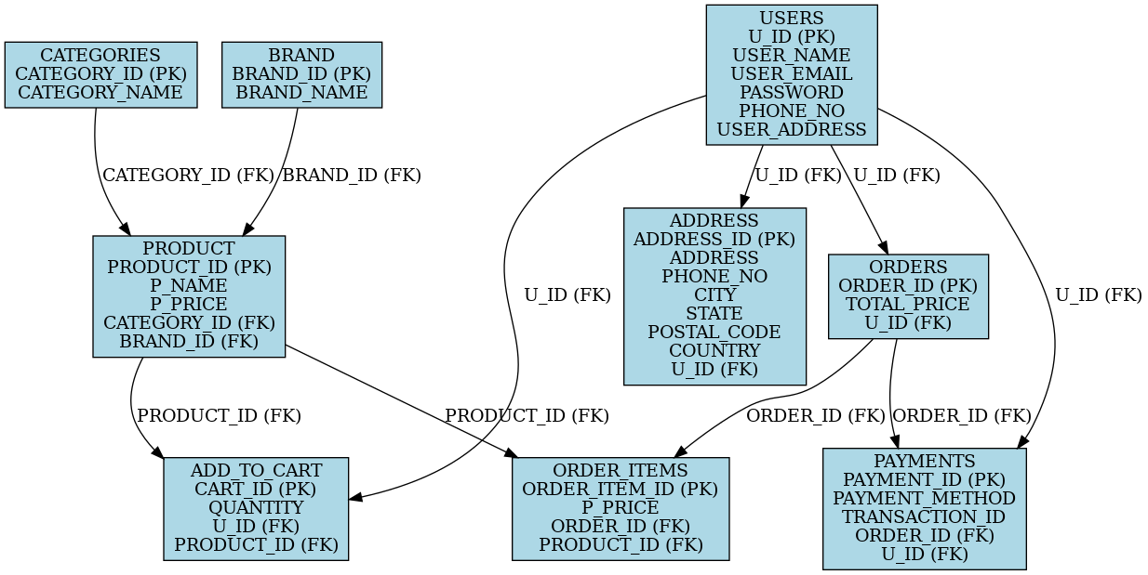
Entity-Relationship (ER) Diagram

Slide 17

Conclusion
This SQL database provides a strong foundation for e-commerce applications. With efficient data management, secure transactions, and seamless user experience, it ensures scalability and reliability for online shopping platforms.

Slide 18


